Slide 1
Unattended Medical Appointments: Analysis and Prediction
Bowen Sebastiano, Dal Tio Leonardo, Fratello Mattia, Govi David, Merola Paolo

Slide 2

Public Health System Estimates
Costs up to 2500 € per capita in 2016
Dissatisfaction for waiting time on the rise
(34,3% in 2015 → 40,3% in 2016)

Slide 3



Efficiency & Efficacy
?

Slide 4
Efficiency & Efficacy
Users

Slide 5
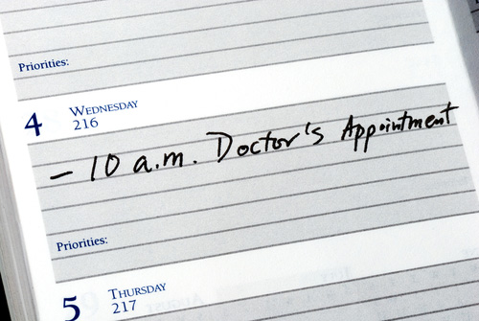
The Problem of Unattended Appointments (Lombardy)
10% of total appointments
Work time of trained medical operator
60.000.000 €
Longer waiting lists
6’ every hour

Slide 6
Current Solutions
1
2
3

Slide 7

Current Solutions
2
3
Reminders

Slide 8

Current solutions
3
Reminders
Queue Management Systems

Slide 9

Current solutions
Reminders
Queue Management Systems
Penalties

Slide 10
Current solutions
Reminders
Queue Management Systems
Penalties
In Lombardy (ITALY) still 10% of total medical APPOINTMENTS are UNATTENDED

Slide 11
What if we could Predict Unattended Appointments?

Slide 12

What if we could Predict Unattended Appointments?
Improved Reminders

Slide 13
What if we could Predict Unattended Appointments?
Improved Queue Management Systems

Slide 14
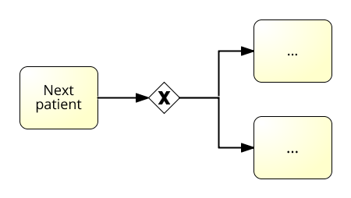
What if we could Predict Unattended Appointments?
Using the information in
Business Process Architecture

Slide 15



Prediction of missed appointments
Probable Unattended Appointments
1
2
3

Slide 16

1. Dataset
«Medical Appointment No Shows»
A dataset of medical appointments in the Brasilian city of Vitoria
110k Appointments
15 Features
https://www.kaggle.com/joniarroba/noshowappointments

Slide 17
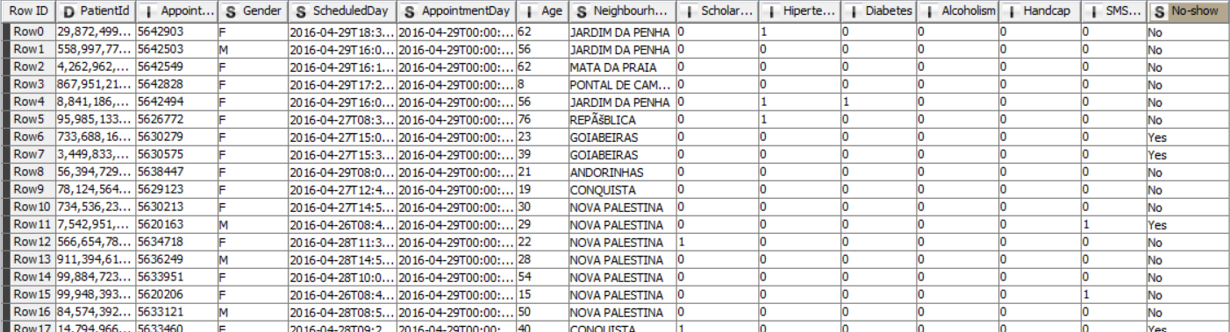
2. Data Manipulation in a Nutshell
Preprocessing

Slide 18
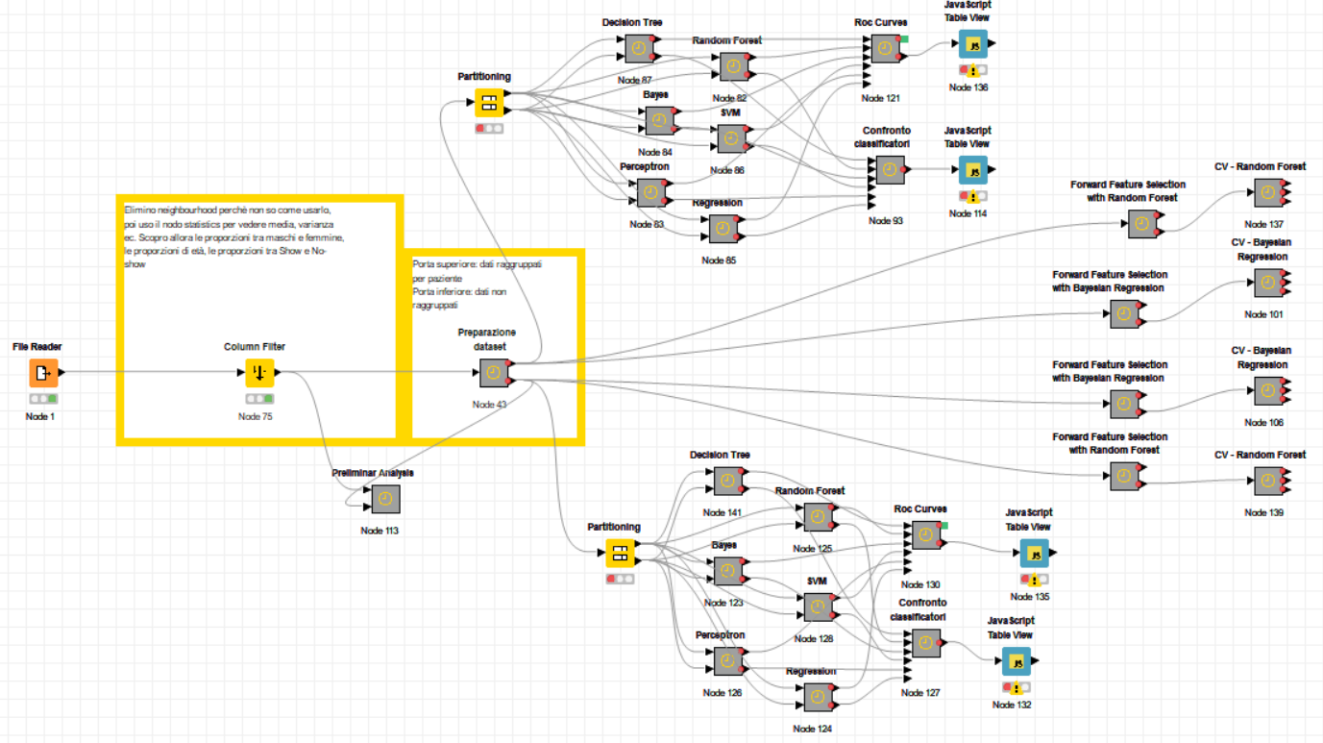
2. Data Manipulation in a Nutshell
Model Training

Slide 19
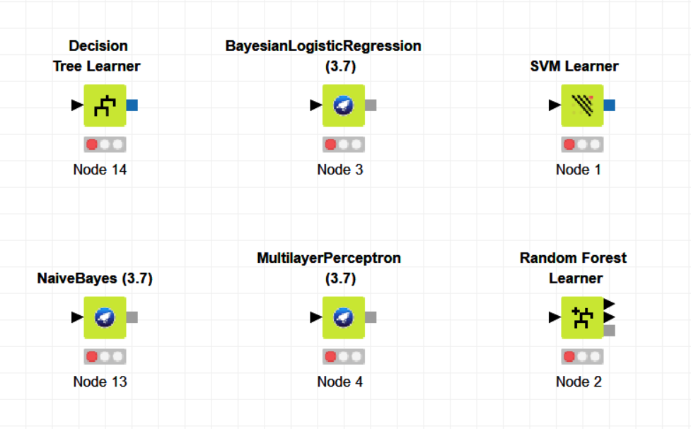
2. Data Manipulation in a Nutshell
Algorithm Choice

Slide 20
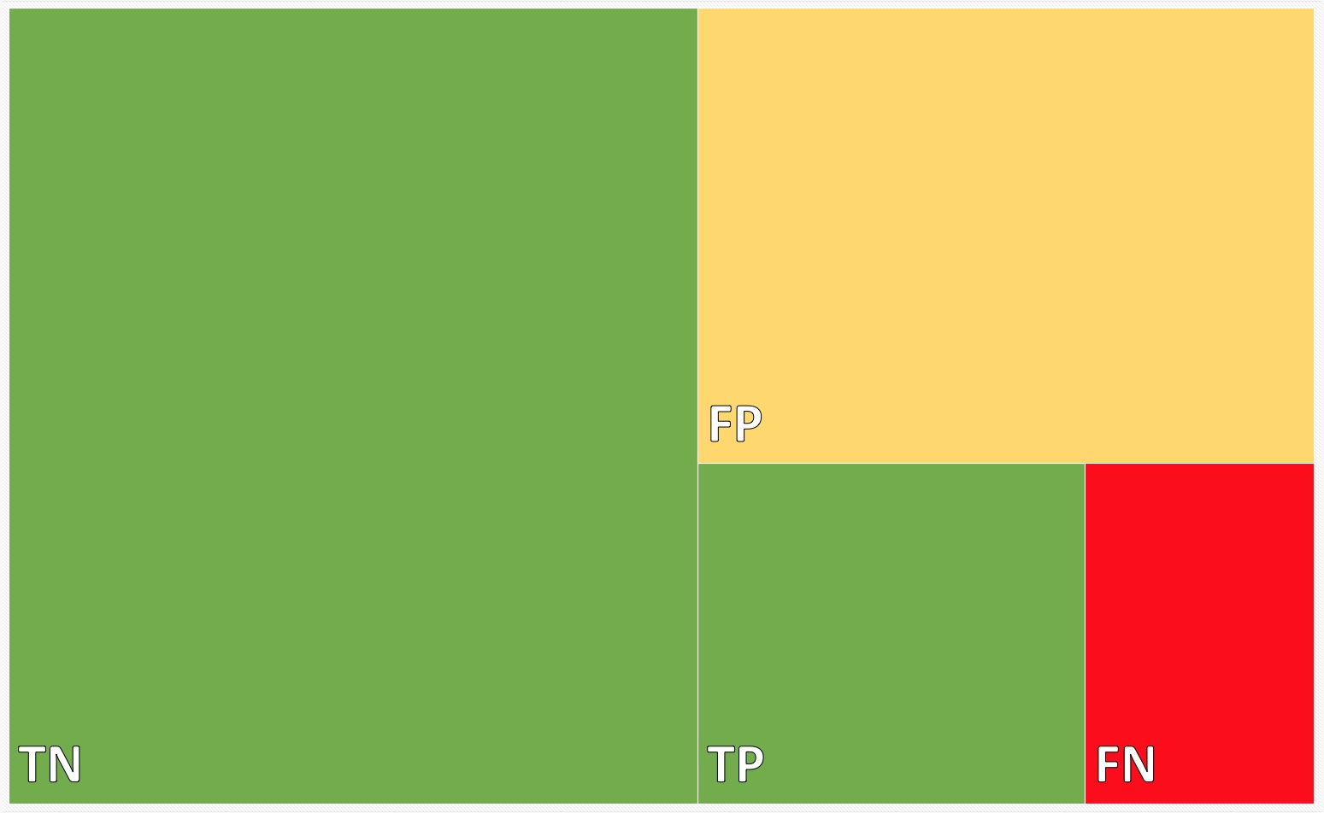
3. Results
27%
Accuracy: 66%
52,8%
12,7%
7,5%
Recall: 63%
7.620.000 € Potential Saving

Slide 21



3. Results
66%
27%
7,5%

Slide 22

How to improve results?
Better Parameter Choice
EG: a Dynamic/Rolling
rating score for each patient
Better Data

Slide 23
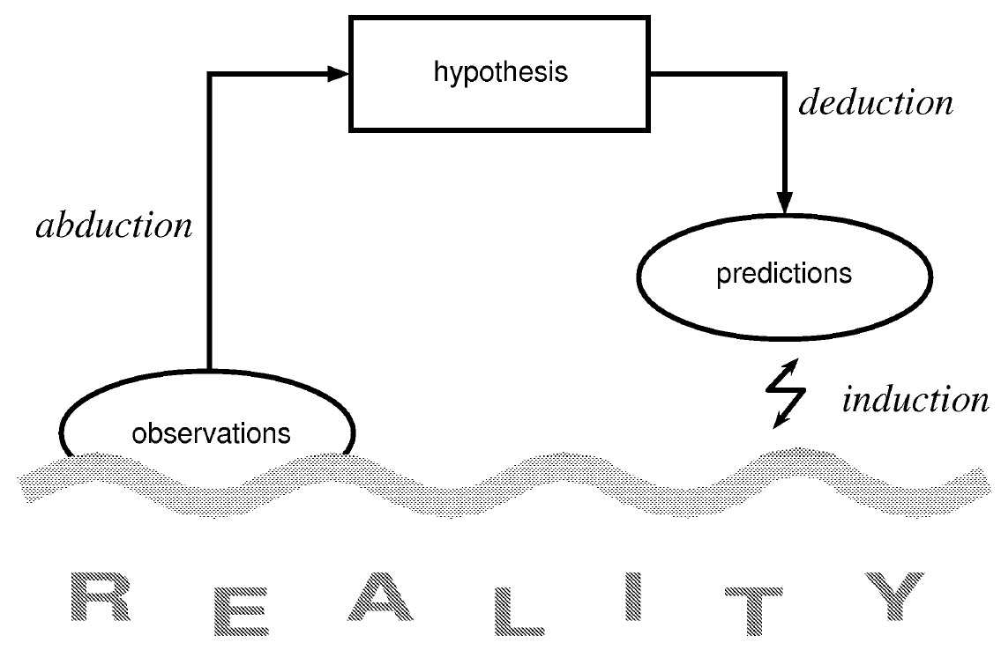
How to improve results?
Test the Model in more concrete situations (closer to us)
Improve Domain Knowledge
Talk to Public Health Actors (we are in contact with Ospedale-Niguarda)
Empirical feedback

Slide 24
Thanks for your attention. References: [1] Kaggle. 2017. Medical Appointment No Shows. [ONLINE] Available at: https://www.kaggle.com/joniarroba/noshowappointments [2] Weather Underground. 2016. Vitoria Aeroporto, Brazil. [ONLINE] Available at: https://goo.gl/mdxRx7 [3] Il Sole 24 Ore. 2012. Se salti la visita medica prenotata scatta la segnalazione a Equitalia. [ONLINE] Available at: http://www.ilsole24ore.com/art/notizie/2012-01-06/saltivisita- medica-prenotata-105246.shtml?uuid=AaWlXIbE [4] Repubblica. 2017. Sanità Lombardia, più di un milione di visite prenotate e disertate: chi non cancella pagherà alla successiva. [ONLINE] Available at: https://goo.gl/36aXbV

